Slide 1
___________________________ ______________
Name Prefix
____________________ _____________________
Job Species
_____________________ _____________________
Negative trait Positive trait
STR
BRAIN
NIM
REA
CON
SOC
___________________________________________________ ___________________________________________________
Short description

Slide 2

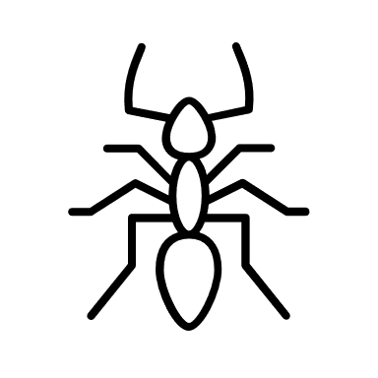


COMBAT
ACY
H-PR-M
/
HP
/
Shield
Size
Speed
REA
/
Armor
Attacks
Rage O O O
Fear O O O
Status Effects
LEVELLING
/
Job Lvl
/
Magic Lvl
MENTAL HEALTH
Adrenaline
/5
Exhaustion
O Aggressiv
O Ängstlich
Adrenaline
/
Sanity

Slide 3
Basic needs
__________________
__________________
__________________
__________________
__________________
__________________
Survival (money/food)
__________________
__________________
__________________
__________________
__________________
__________________
Social needs (Acceptance)
__________________
__________________
__________________
__________________
__________________
__________________
Other stuff (superiority)
Empathy
______________________________________________________________
______________________________________________________________
______________________________________________________________
______________________________________________________________
______________________________________________________________
______________________________________________________________
______________________________________________________________
______________________________________________________________
______________________________________________________________
______________________________________________________________
______________________________________________________________
Backstory

